Slide 1
CENG401 MACHINE LEARNING AND ARTIFICIAL INTELLIGENCE
WEEK-5
Adversarial Search
Asst.Prof.Dr. Murat ŞİMŞEK

Slide 2
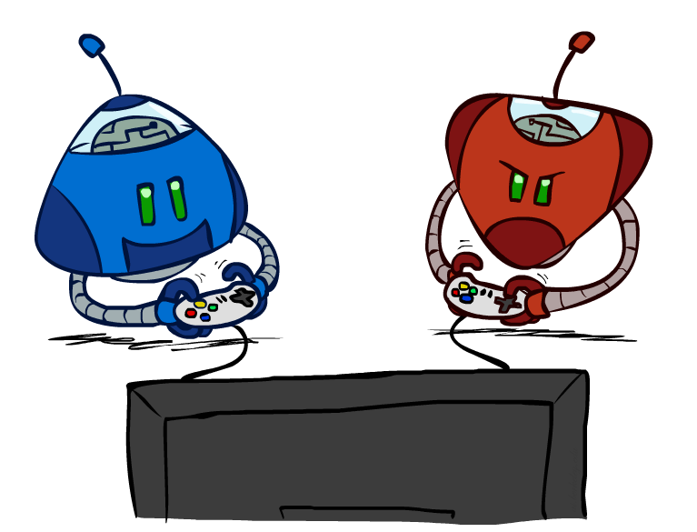
ADVERSARIAL SEARCH
Adversarial search is basically a kind of search in which one can trace the movement of an enemy or opponent.
Notes:
Adversarial search is basically a kind of search in which one can trace the movement of an enemy or opponent. The step which arises the problem for the user or the user or the agent doesn't want that specific step task to be carried out.

Slide 3
ADVERSARIAL SEARCH
Adversarial search is a search, where we examine the problem which arises when we try to plan ahead of the world and other agents are planning against us.
However, there may be times when more than one agent is searching for the same answer in the same search space, which is common in game play.
The environment with more than one agent is referred to as a multi-agent environment, in which each agent is an adversary to the other and competes against them.
Each agent must consider the actions of other agents as well as the consequences of their actions.
Each agent have to consider the action of the other agent and effect of that action on their performance.

Slide 4
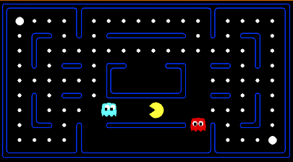
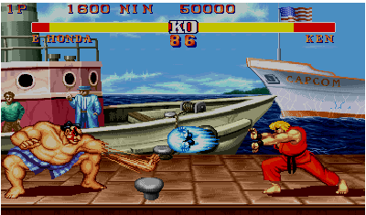
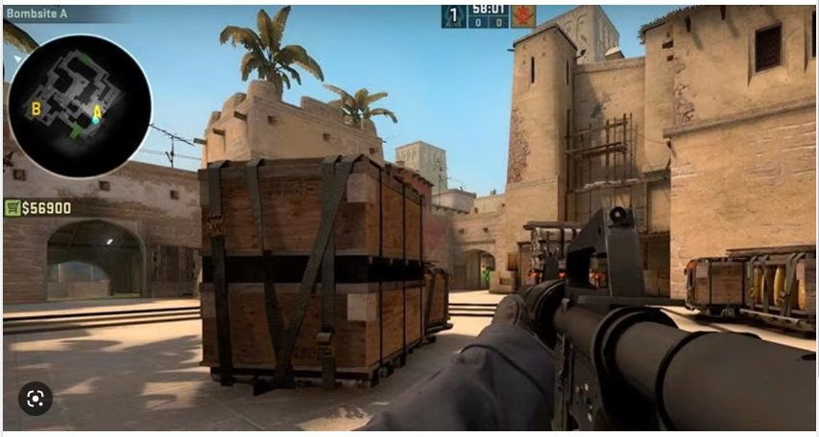
Games

Slide 5
Games
Multi agent environments : any given agent will need to consider the actions of other agents and how they affect its own welfare.
The unpredictability of these other agents can introduce many possible contingencies.
There could be competitive or cooperative environments
Competitive environments, in which the agent’s goals are in conflict require adversarial search – these problems are called as GAMES

Slide 6
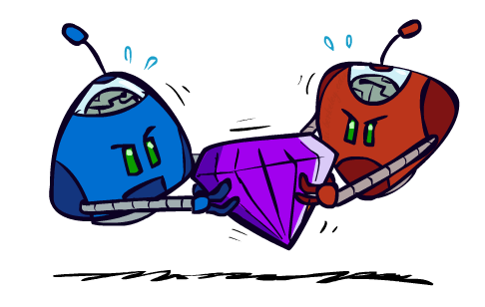
Games

Slide 7
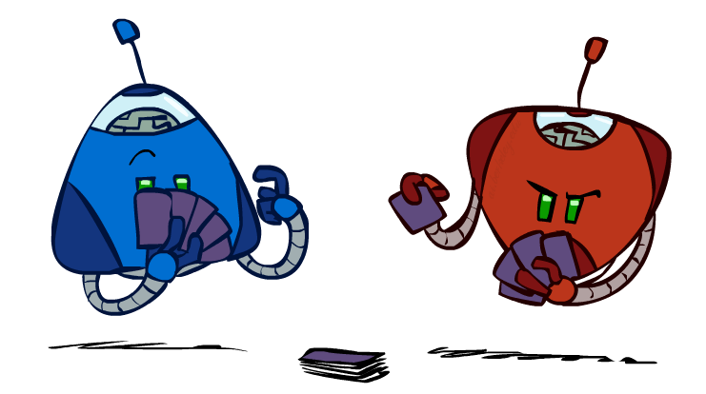
Games
Many different kinds of games!
Deterministic or stochastic
One, two, or more players
Zero sum
Perfect information

Slide 8
Games
 | Deterministic | Chance Moves
Perfect Information | Chess, Go | Backgammon, Monopoly
Imperfect Information | Battleship, Tic-Tac-Toe | Poker, Scrabble
Deterministic games: Deterministic games are those games which follow a strict pattern and set of rules for the games, and there is no randomness associated with them.
Examples are chess, Checkers, Go, tic-tac-toe, etc.
Non-deterministic games: Non-deterministic are those games which have various unpredictable events and has a factor of chance or luck.
This factor of chance or luck is introduced by either dice or cards.
These are random, and each action response is not fixed.
Such games are also called as stochastic games.
Example: Backgammon, Monopoly, Poker, etc.

Slide 9
Games
 | Deterministic | Chance Moves
Perfect Information | Chess, Go | Backgammon, Monopoly
Imperfect Information | Battleship, Tic-Tac-Toe | Poker, Scrabble
Perfect information: A game with the perfect information is that in which agents can look into the complete board.
Agents have all the information about the game, and they can see each other moves also.
Examples are Chess, Go, etc.
Imperfect information: If in a game agents do not have all information about the game and not
aware with what's going on, such type of games are called the game with imperfect information, such as tic-tac-toe, Battleship, etc.

Slide 10
Game Search Problem
Problem formulation
Initial state: initial board position + whose move it is
Operators: legal moves a player can make
Goal (terminal test): game over?
Utility (payoff) function: measures the outcome of the game and its desirability
Search objective:
Find the sequence of player’s decisions (moves) maximizing its utility (payoff)
Consider the opponent’s moves and their utility

Slide 11
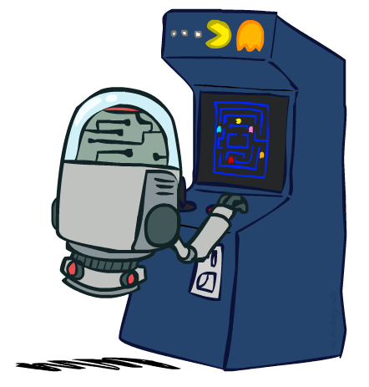
Deterministic Games
Many possible formalizations, one is:
States: S (start at s₀)
Players: P={1...N} (usually take turns)
Actions: A (may depend on player / state)
Transition Function: SxA → S
Terminal Test: S → {t,f}
Terminal Utilities: SxP → R
Solution for a player is a policy: S → A

Slide 12
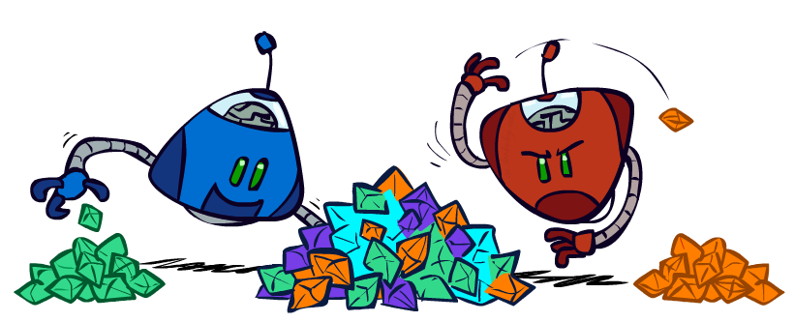
Zero-Sum Games
Zero-Sum Games
Agents have opposite utilities (values on outcomes)
Lets us think of a single value that one maximizes and the other minimizes
Adversarial, pure competition
General Games
Agents have independent utilities (values on outcomes)
Cooperation, indifference, competition, and more are all possible
More later on non-zero-sum games

Slide 13
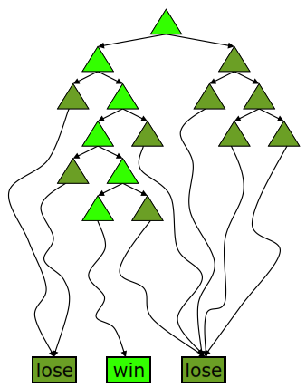
Deterministic Single-Player
Deterministic, single player, perfect information:
Know the rules
Know what actions do
Know when you win
E.g. Freecell, 8-Puzzle, Rubik’s cube
… it’s just search!
Slight reinterpretation:
Each node stores a value: the best outcome it can reach
This is the maximal outcome of its children (the max value)
Note that we don’t have path sums as before (utilities at end)
After search, can pick move that leads to best node
Slide adapted from Macskassy

Slide 14
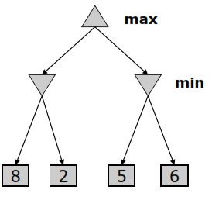
Deterministic Two-Player
E.g. tic-tac-toe, chess, checkers
Zero-sum games
One player maximizes result
The other minimizes result
Minimax search
A state-space search tree
Players alternate
Each layer, or ply, consists of a round of moves
Choose move to position with highest minimax value = best achievable utility against best play

Slide 15
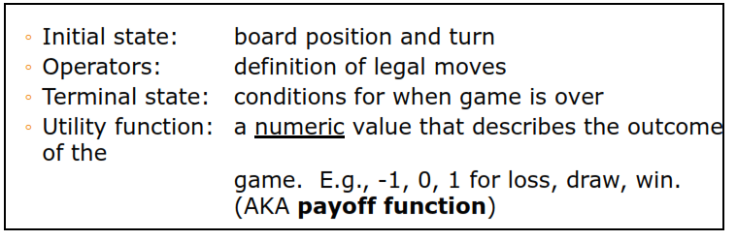
Two-player Games
A game formulated as a search problem:

Slide 16
Game Tree
A game tree is a tree where nodes of the tree are the game states and Edges of the tree are the moves by players.
Game tree involves initial state, actions function, and result Function.

Slide 17
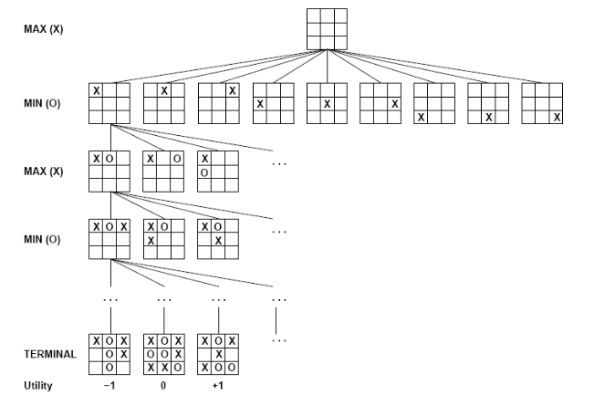
Example: Tic-Tac-Toe
There are two players MAX and MIN.
Players have an alternate turn and start with MAX.
MAX maximizes the result of the game tree
MIN minimizes the result.
Notes:
There are two players MAX and MIN.
Players have an alternate turn and start with MAX.
MAX maximizes the result of the game tree
MIN minimizes the result.

Slide 18
The minimax algorithm
Perfect play for deterministic environments with perfect information
Basic idea: choose move with highest minimax value
= best achievable payoff against best play
Algorithm:
1. Generate game tree completely
2. Determine utility of each terminal state
3. Propagate the utility values upward in the three by applying MIN and MAX operators on the nodes in the current level
4. At the root node use minimax decision to select the move with the max (of the min) utility value
Steps 2 and 3 in the algorithm assume that the opponent will play perfectly.

Slide 19
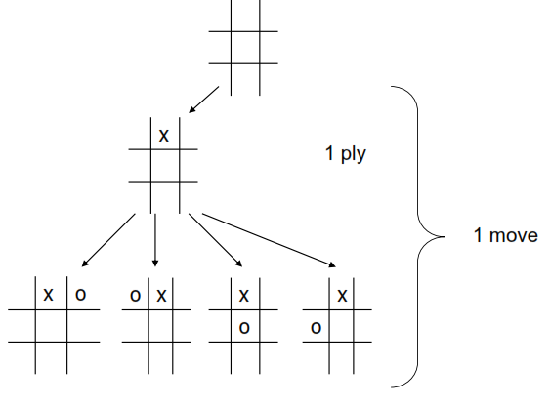
Generate Game Tree

Slide 20
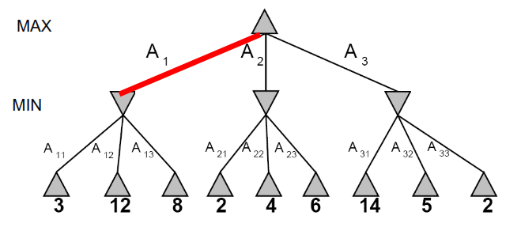
Minimax Example

Slide 21
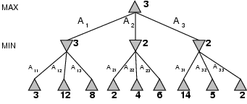
The Minimax Algorithm Properties
Perfect play for deterministic games
Idea: choose move to position with highest minimax value = best achievable payoff against best play
E.g., 2-ply game:

Slide 22
Alpha-Beta Pruning
α: MAX’s best option on path to root
β: MIN’s best option on path to root
def max-value(state, α, β):
initialize v = -∞
for each successor of state:
v = max(v, value(successor, α, β))
if v ≥ β return v
α = max(α, v)
return v
def min-value(state , α, β):
initialize v = +∞
for each successor of state:
v = min(v, value(successor, α, β))
if v ≤ α return v
β = min(β, v)
return v
Notes:
Pick an order for two reasons: sequential processor and pruning

Slide 23
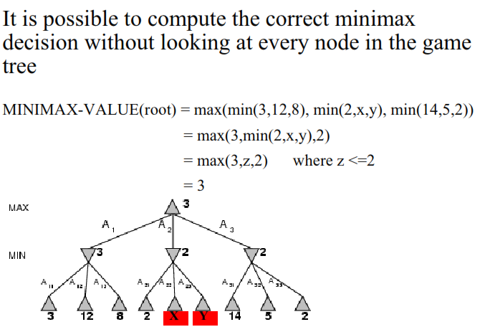
α-β pruning

Slide 24
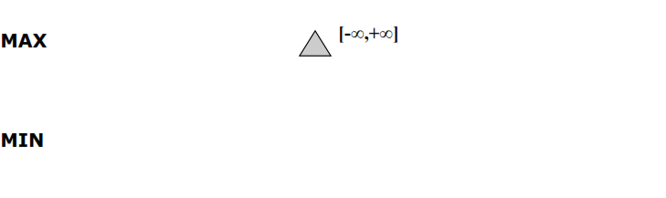
α-β pruning: example

Slide 25
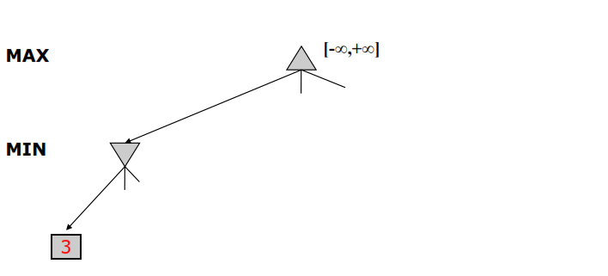
α-β pruning: example

Slide 26
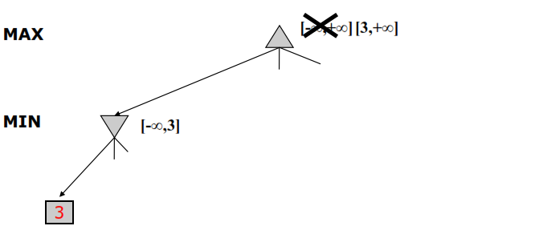
α-β pruning: example

Slide 27
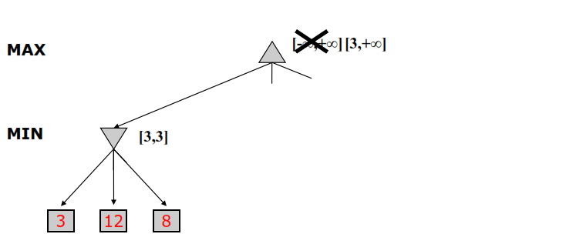
α-β pruning: example

Slide 28
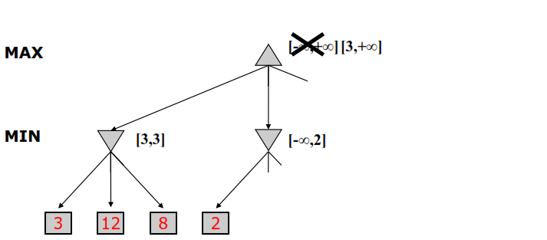
α-β pruning: example

Slide 29
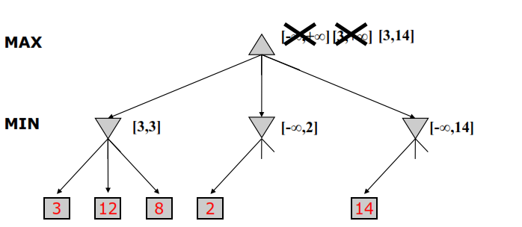
α-β pruning: example

Slide 30
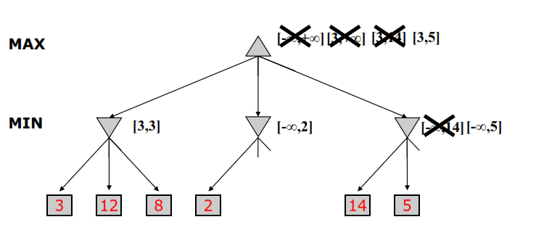
α-β pruning: example

Slide 31
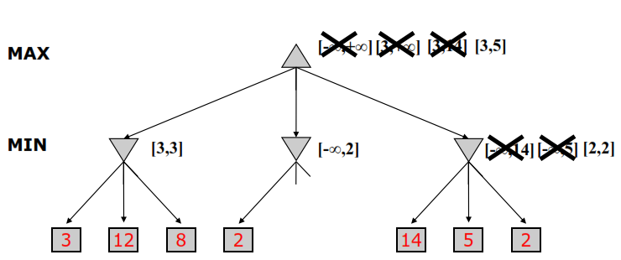
α-β pruning: example

Slide 32
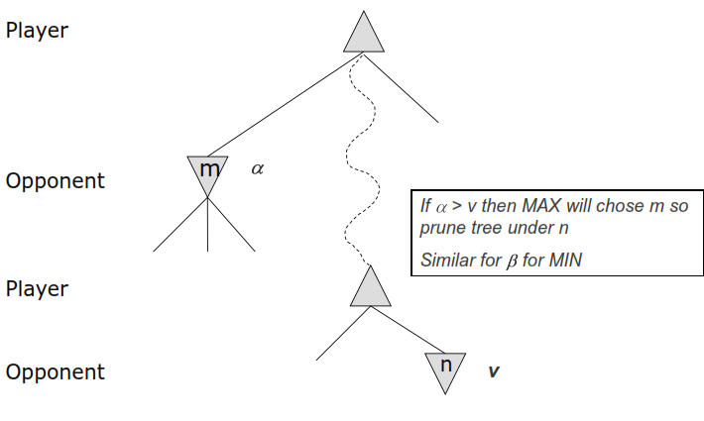
α-β pruning: General Principle

